Slide 1

Documentation Best Practices
Lecture for QBS 101.5 by Carly Bobak

Slide 2
Sharing code is an essential part of being a data scientist
Reproducibility: Sharing code allows other researchers and collaborators to reproduce your results and verify the findings, promoting transparency and scientific integrity.
Collaboration: Code sharing enables effective collaboration among team members and facilitates knowledge exchange, leading to improved project outcomes and accelerated progress.
Knowledge Transfer: Sharing code allows data scientists to share their expertise, best practices, and insights with the broader community, fostering a culture of continuous learning and improvement.
Validation and Improvement: By sharing code, data scientists invite peer review and feedback, leading to better code quality, identification of errors, and opportunities for improvement.

Slide 3






Sharing code is an essential part of being a data scientist
Building upon Existing Work: Shared code serves as a foundation for new projects and research, saving time and effort by reusing code components and established methodologies.
Open Science and Replicability: In the spirit of open science, sharing code promotes replicability and allows others to build upon published research, advancing the field collectively.
Career Advancement: Sharing well-documented and high-quality code showcases a data scientist's skills, expertise, and contributions to the community, potentially leading to career opportunities and recognition.
Community Engagement: Code sharing fosters a vibrant and collaborative community of data scientists who can support each other and work together to tackle complex problems.
Error Detection and Debugging: When code is shared, issues and bugs are more likely to be identified and resolved quickly through collaborative efforts.

Slide 4
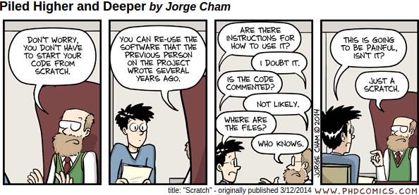

Slide 5
Guidelines for Writing Code
Code should be logical
Despise redundancy
Separate functional code and metadata
Use the right data structures
Code should be readable
Keep it short
Order your functions for linear reading
Choose descriptive names
Use white space and indents to make code scannable

Slide 6
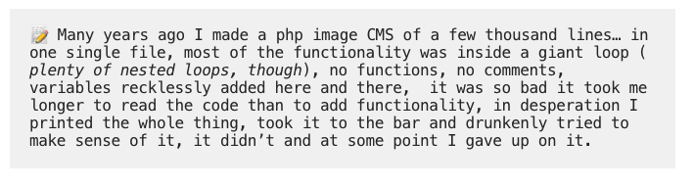
Spaghetti Code

Slide 7
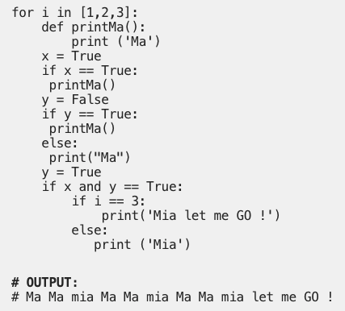
Notes:
Why is this spaghetti code?

Slide 8
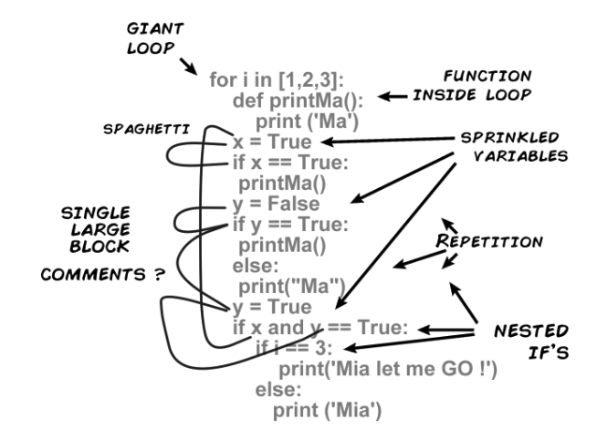

Slide 9
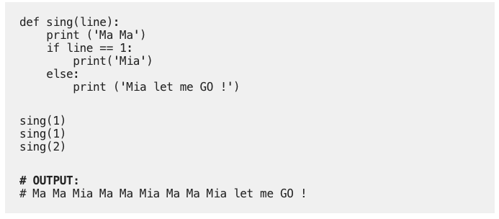

Slide 10
More Guidelines for Writing Code
Code should be robust
Check for errors
Write tests
Code should be efficient
Profile slow code relentlessly
Separate slow code from fast code
Notes:
Ex. You can’t dive by zero, add a check to make sure functional input does not try AND print an informative message

Slide 11
Documentation
GOAL : Be able to perfectly reproduce the results of an analysis following documentation
Notes:
Documentation should be BORING. Like following a protocol or recipe with exact instructions.

Slide 12
Documentation
Metadata in front of a script
Textual annotation in line with code
Comments in code
README files

Slide 13
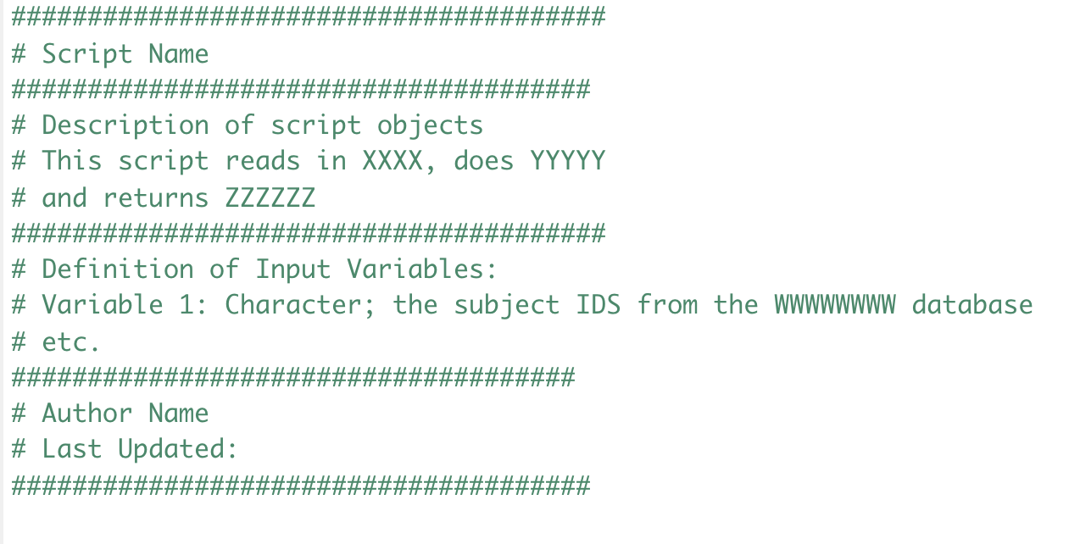
Metadata in front of a Script

Slide 14
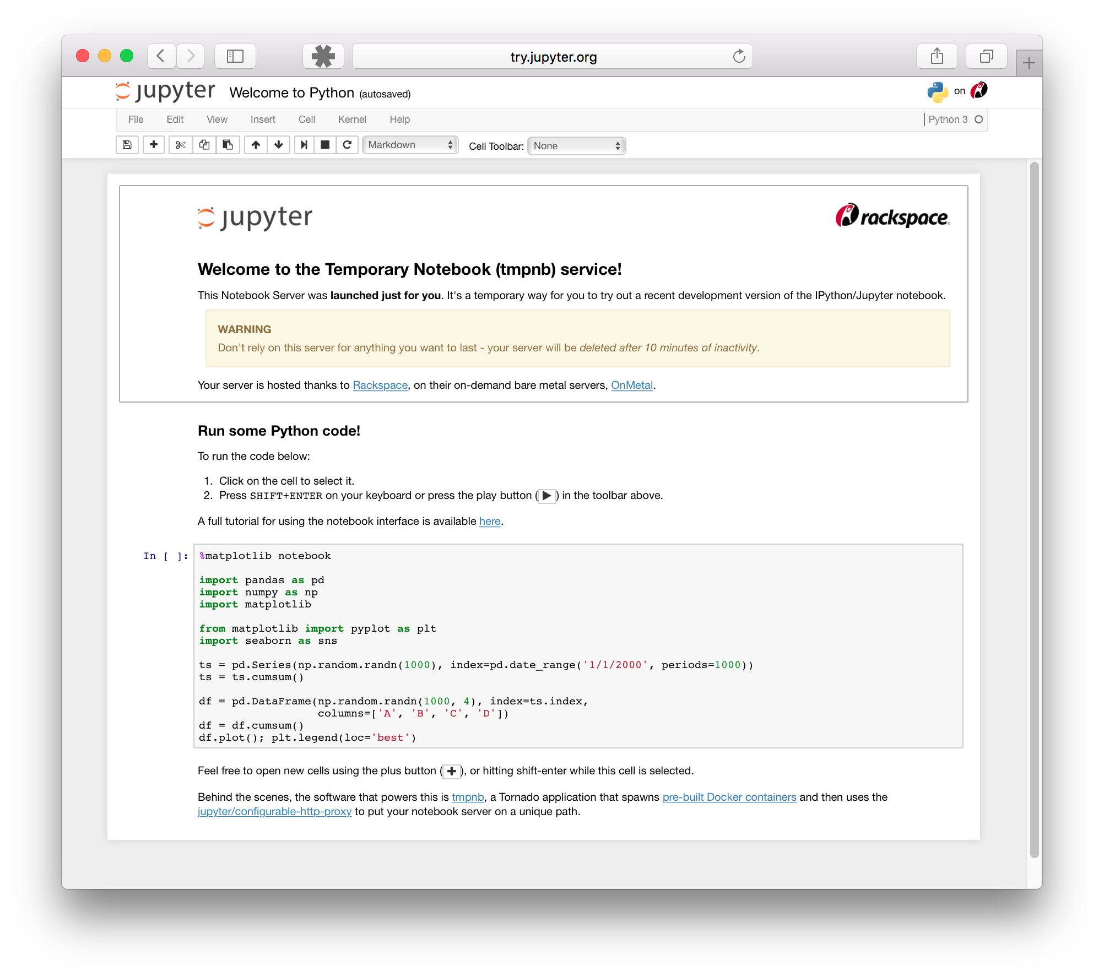
Notes:
Talk about how to properly use notebooks here.

Slide 15
Script or Markdown Document?
Sometimes, both.
Scripts are best for just running, as is, on data, locally or on a server
Markdowns are best for tutorials, blogs, presentations, training new scientists, and/or other circumstances where the goal is to illustrate a use case

Slide 16
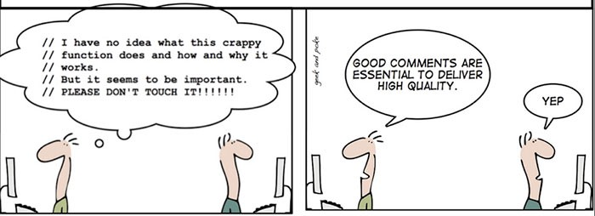

Slide 17
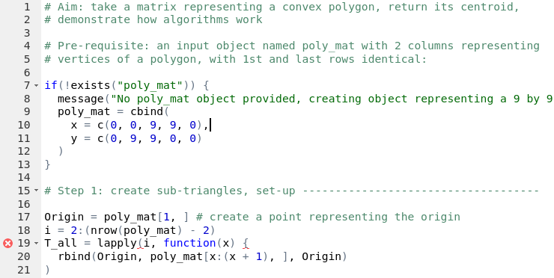
Commenting best practice
Overall Comments about functionality
Annotating chunks of code with steps
Add individual line comments where helpful

Slide 18
README File Contents
Vital for Every Project: Title, Authors, Description, Date, License
Vital for Programs: Language Versions, Dependencies, Dependency Versions, Git Commit, proper version number, How to Install
Vital for Larger Programs: Tests, How to run Tests, Run Times Under Commonly Used Platforms, Sample Input and Output Data, Sample Run Usage

Slide 19
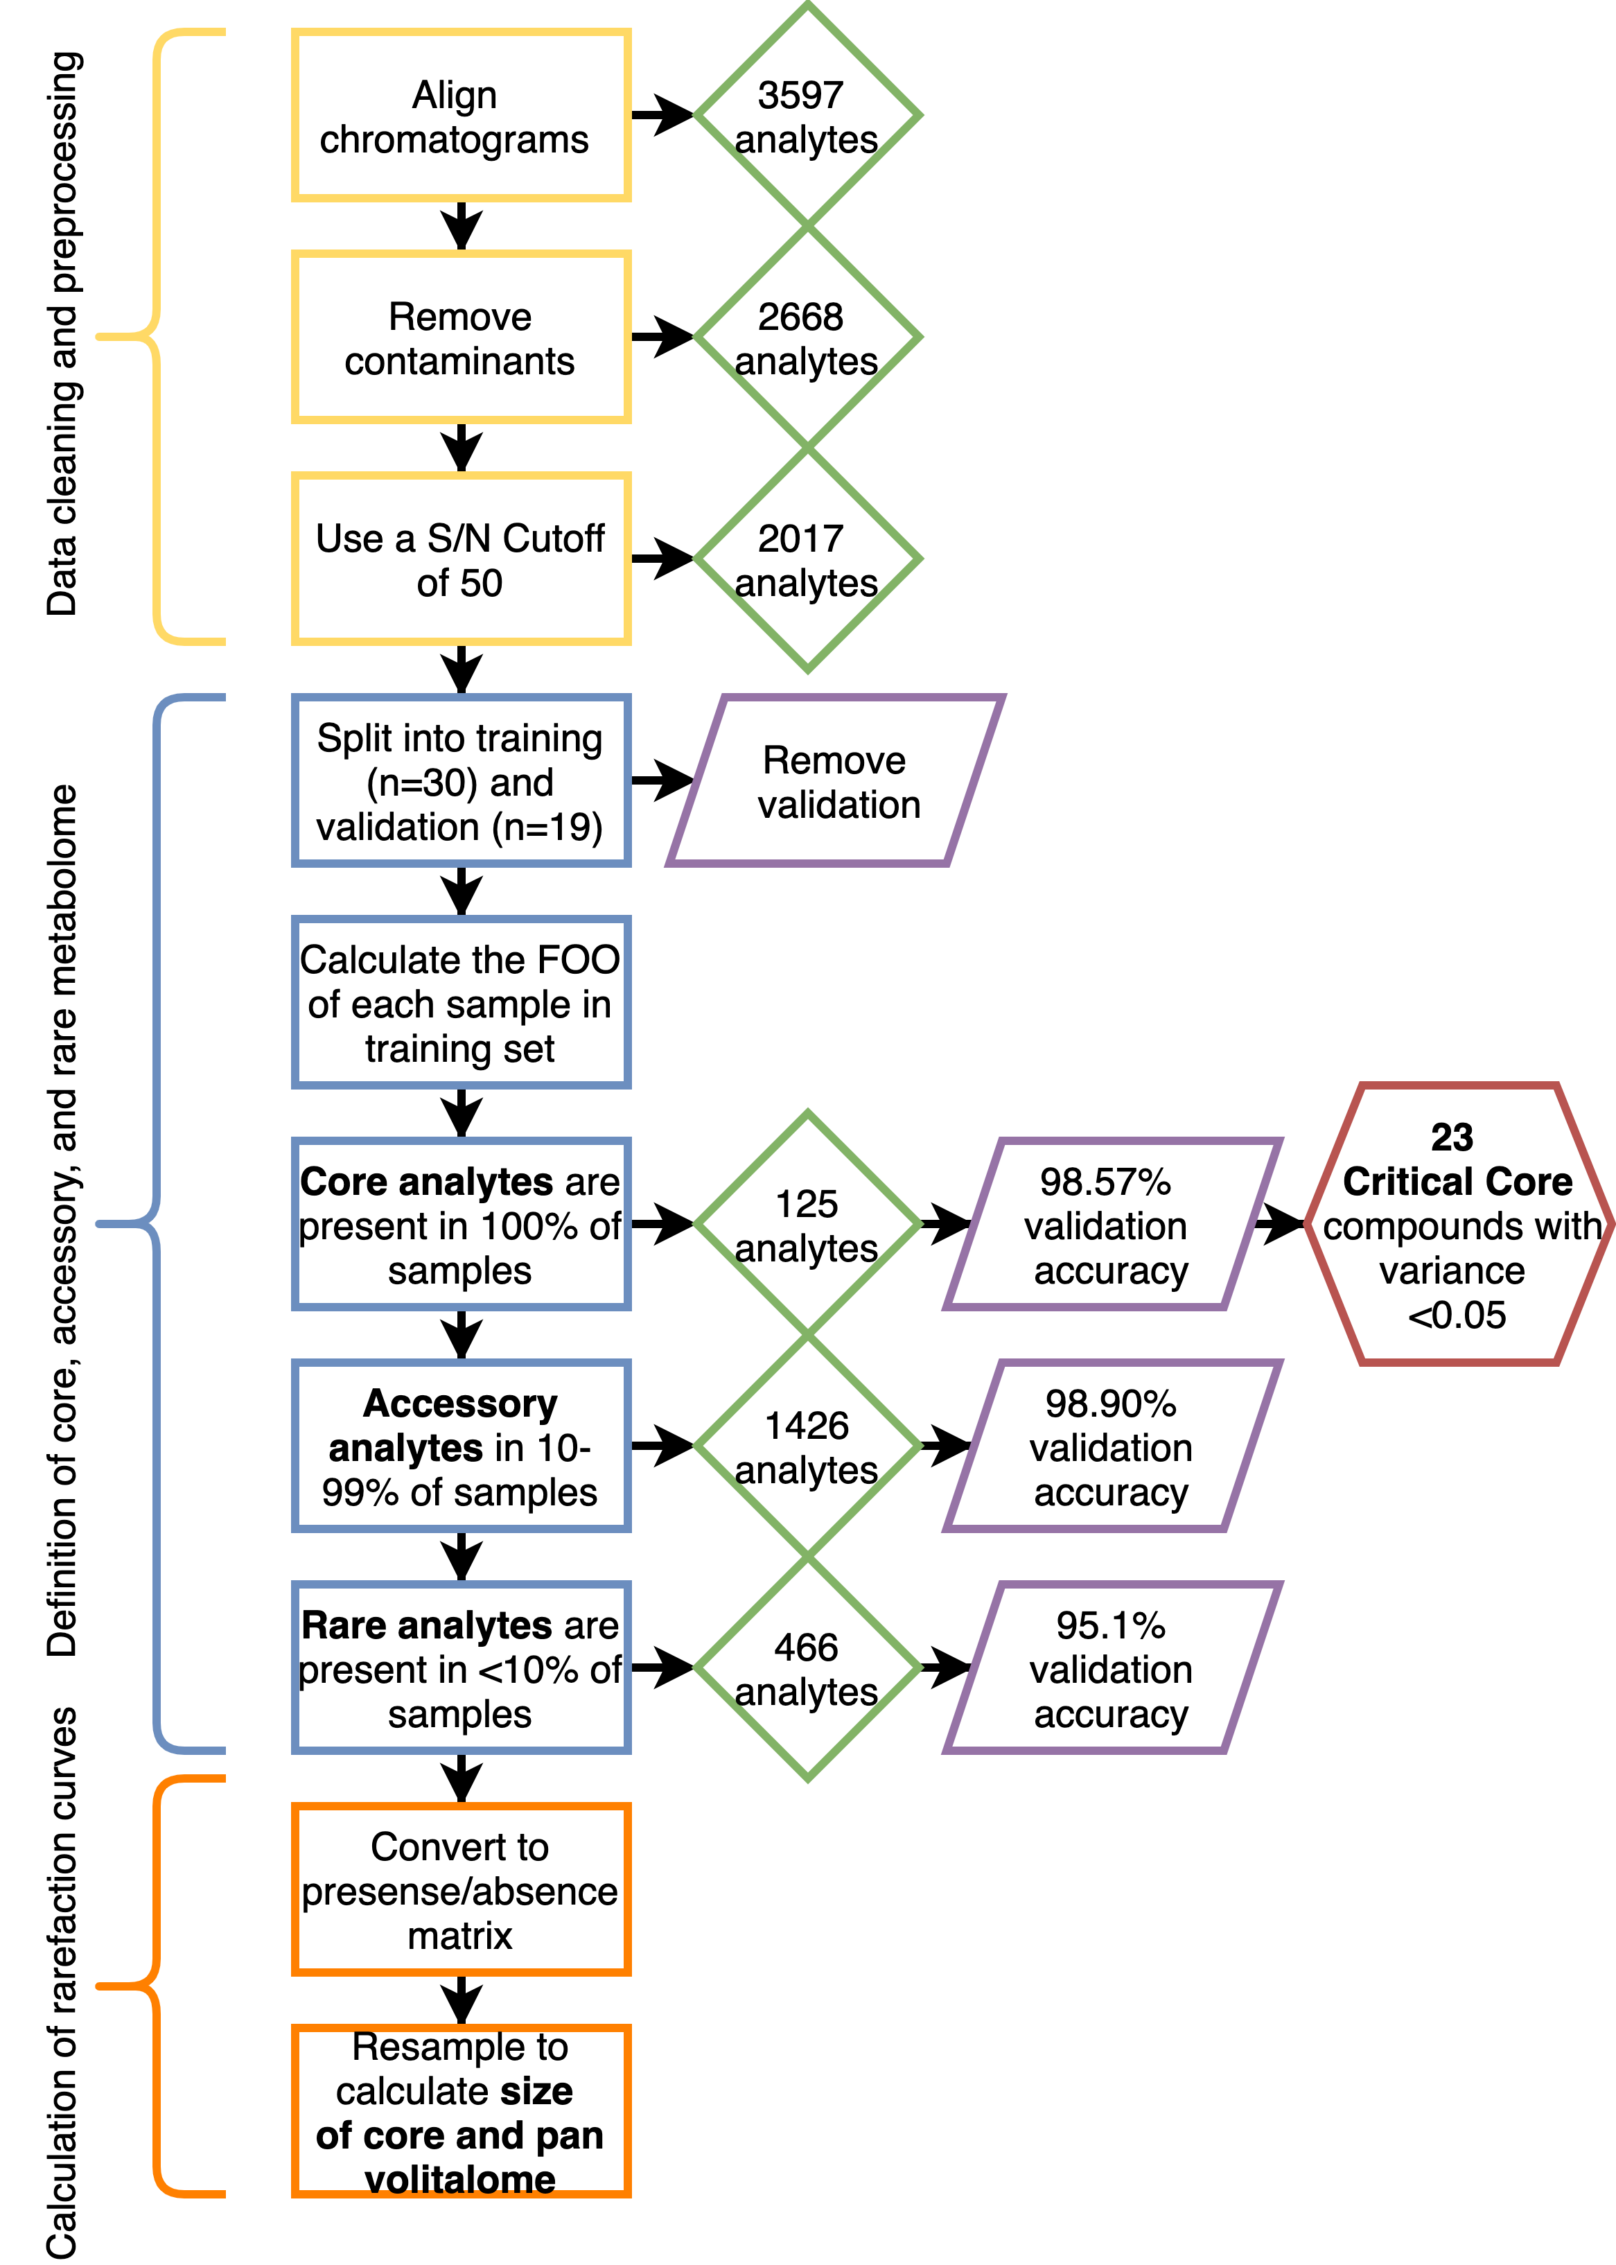
Include guiding flow charts as part of supplementary/
documentation material!
Recommended Tool: draw.io

Slide 20
Documentation Checklist
Is it clear where to begin?
Can you determine which files was/were used as input to produce derived files?
Who/How should things be cited?
Is there documentation about every result?
Is the exact version of every application used noted?
Are use cases described?
Are random seeds noted?
Is the license under which content is distributed noted?
Have you noted other people’s licenses?

Slide 21
Organization Checklist
Is the organizational structure documented and up to date?
Which is the most recent data file/code?
Which folders can safely be deleted?
How are older files archived?
Is the raw data and all intermediary steps stored and annotated?
Is data backed up?

Slide 22
Automation Checklist
Are there many manual steps?
Are these steps documented?
Are drivers of decisions behind these steps documented?
Are scripts under version control
Is the content (writing, documentation, etc) under version control?

Slide 23
Publication Checklist
Are exact versions of all software stated
Is there a reproducibility statement or declaration at the end of the paper?
Are textual statements connected to supporting results or data?
Did you archive preprints of resulting papers in a publicly available repository?
Is the underlying code publicly available at the time of publication?
Is the underlying data available at the time of publication?
Are you providing public access to your scripts, runs, and results?

Slide 24
Publication Preprint Archives
Name | Discipline | Description | Size | Created | Provider
arXiv^{[1]} | Multidisciplinary | Main focus: mathematics, physics, astronomy, computer science, quantitative biology, statistics, quantitative finance and economics | 1,890,028 | 1991 | Cornell University
bioRxiv^{[4]} | Biology | Open access preprint repository for the biological sciences | 106,783 | 2013 | Cold Spring Harbor Laboratory
ChemRxiv^{[5]} | Chemistry | Open access preprint archive for chemistry | 13,865 | 2017 | American Chemical Society, Royal Society of Chemistry & German Chemical Society
Notes:
Publication bias, upload all kinds of projects, thoughts, homework etc.

Slide 25
Git Repositories
GitHub: One of the more popular of the numerous web services that host git repositories online in public (free) or private (not free).
Here are some of the most popular python repositories on GitHub.

Slide 26
Give and Receive Credit for Reproducible Research?
Release media components (text and figures, such as markdown, LaTeX, PDF and other documents) under a Creative Commons Attribution (CC-BY) licence.
Release code components under the MIT license or similar.
Release data under the CC0 licence, that is, place data in the public domain.
There are several options for depositing these components of the research compendia online that give DOIs for convenient citing and discovery (eg. figshare with github integration, zenodo also with github integration, and researchcompendia.org).
Notes:
These recommendations will not be suitable for every occasion. For example, research that uses human subjects data obviously cannot make that data publicly available without substantial changes to protect identities. In these situations, some modifications will be required to maximize reproducibility while honoring obligations to stakeholders. In some cases, a solution might be releasing a sample of “dummy” data that contains similar qualities to the real data set. While this would not be fully ‘reproducible research’ as defined above, it would still be very useful to other researchers who could use a validated sample to inspect, evaluate and extend the research.

Slide 27

Documenting Python Code using Sphinx
Documenting code is time consuming
Many programming languages have tool kits to create high quality documentation easier
In python, Sphinx is a module aimed at creating high quality documentation faster
Many python libraries use Sphinx to document their own code
Tutorial here: https://towardsdatascience.com/documenting-python-code-with-sphinx-554e1d6c4f6d
Documentation here: https://www.sphinx-doc.org/en/master/tutorial/index.html

Slide 28

More Complex Sphinx
3 Part Series Here: https://towardsdatascience.com/advanced-code-documentation-beyond-comments-and-docstrings-2cc5b2ace28a
Use with Jupyter notebooks is part II: https://towardsdatascience.com/advanced-code-documentation-with-sphinx-part-2-32c82860a535

